Slide 1
Using Data to Affect Health Disparities in Minority Communities
Elise Jones ‘21, Joaquim Mitchell ‘21, Kaitan Ireland ‘21, and Andrea Edwards Xavier University of Louisiana
Abstract
COVID is disproportionately affecting the health of minority communities. Public health practitioners use scientific data to address social determinants of health, yet this data is not easily accessible to communities with the greatest need. You!Covid is a software tool to help users assess risks, cue actions, and develop self-efficacy in making behavioral changes to reduce COVID infections. Using Amazon Web Services’ QuickSight, we prepared visualizations to highlight health disparities between people in Orleans Parish, LA and Fairfax County, VA and then we applied the Health Belief Model and the Socioecological Model in analyzing that data. We conclude with specific recommendations that can better inform and protect minority communities.

Slide 2
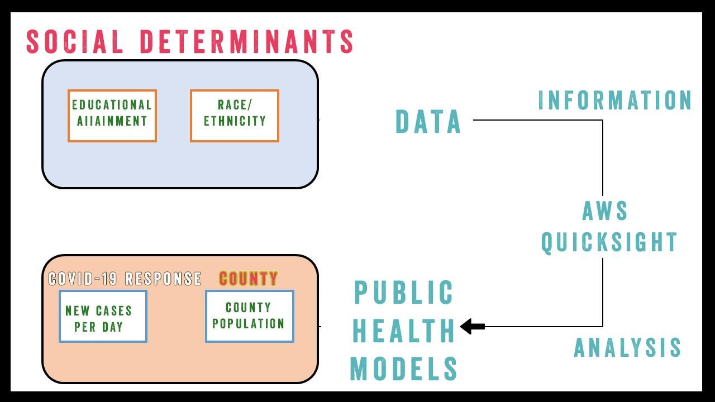
Flow
Left:
Our variables and the category that they fall under
Right:
The process that
we use from acquiring the data, to creating a story, to seeing which public health model the situation falls under.
For each variable listed here, we retrieved a Dataset from Orleans and Fairfax counties

Slide 3
Flow
Visualizations
Input
Health Belief Model and
Socioecological Model
AWS QuickSight
Publicly Available Data Sets from Census.gov
Analysis
Something
Something else
Something profound
Even more profound
Fairfax County
Orleans Parish

Slide 4
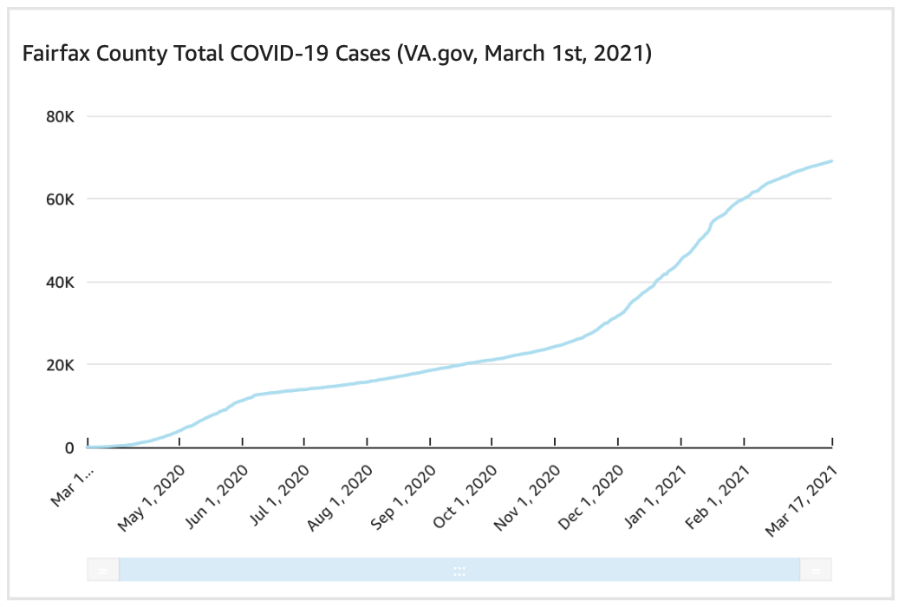
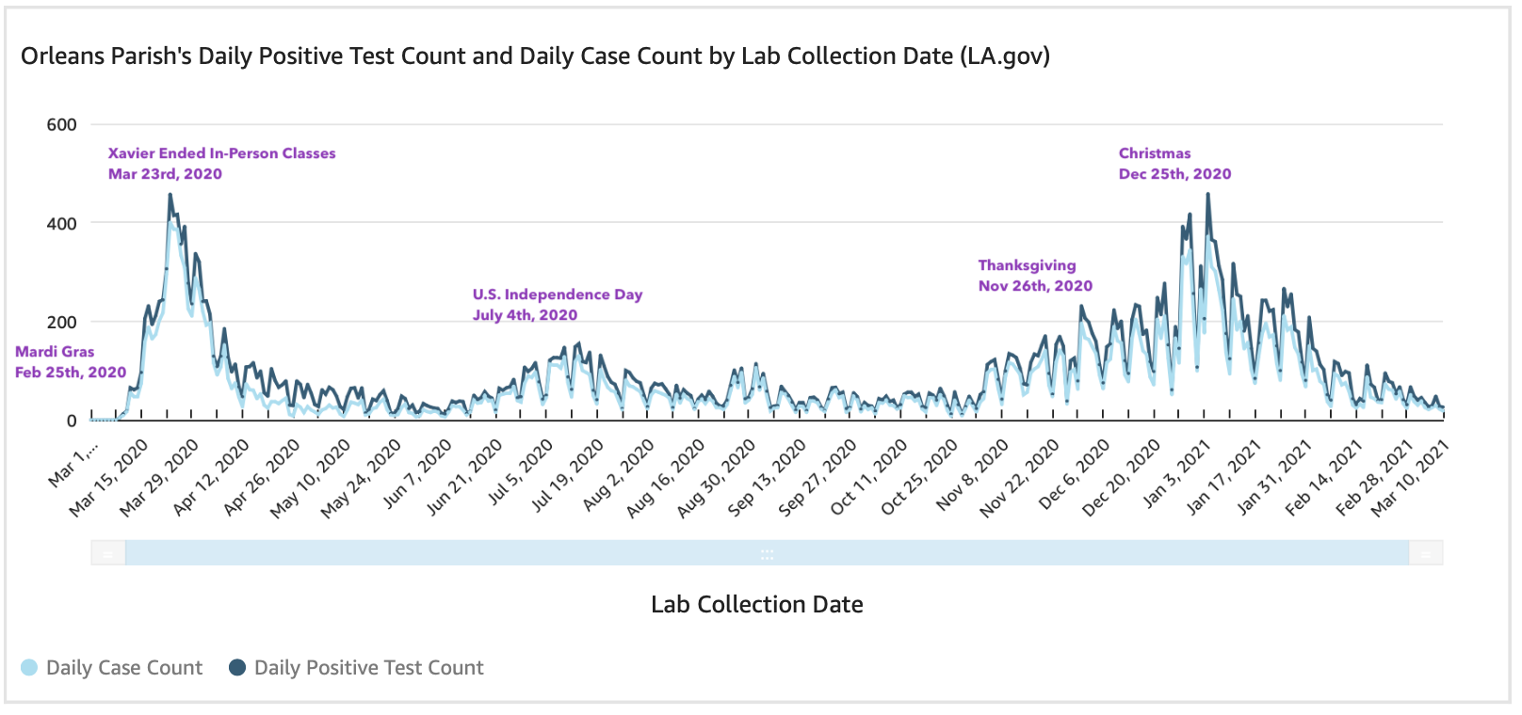
Input

Slide 5
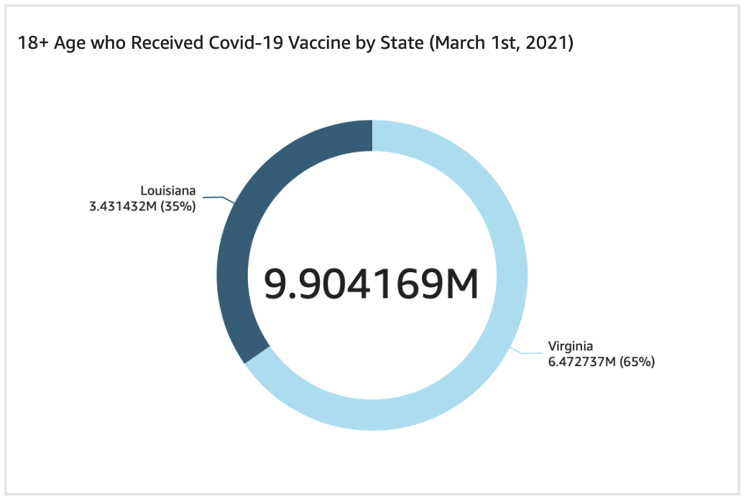
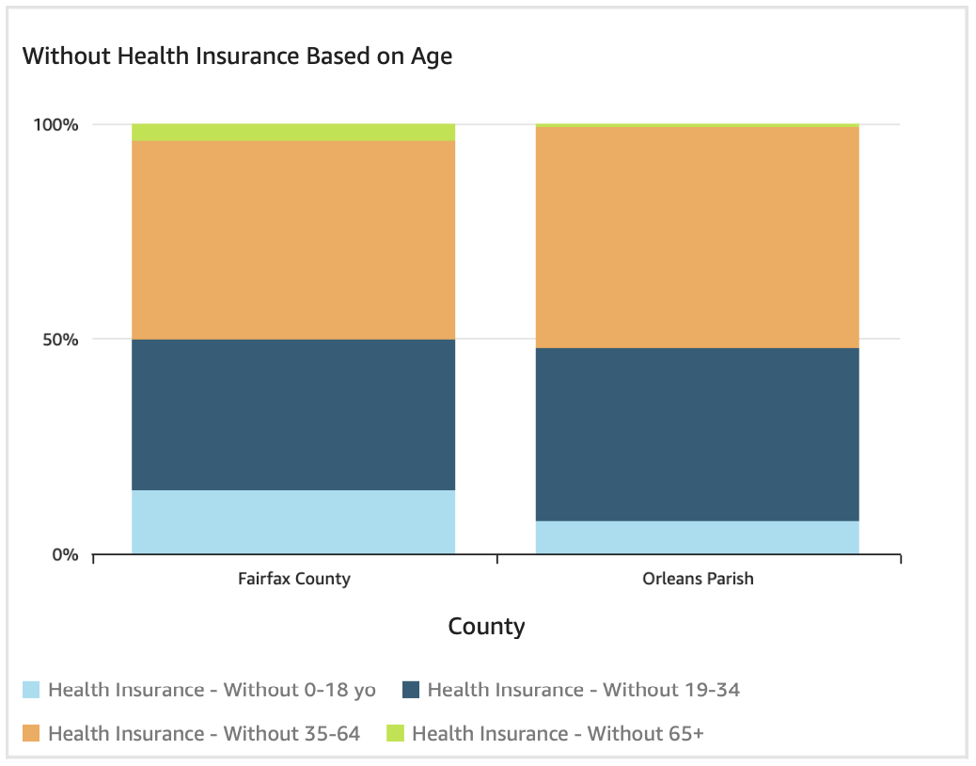
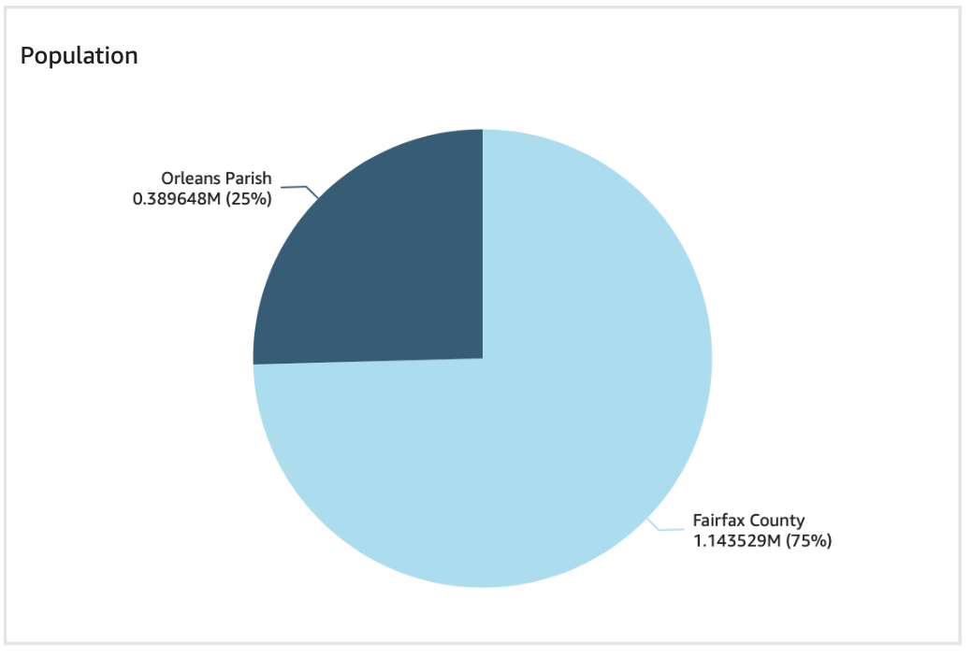
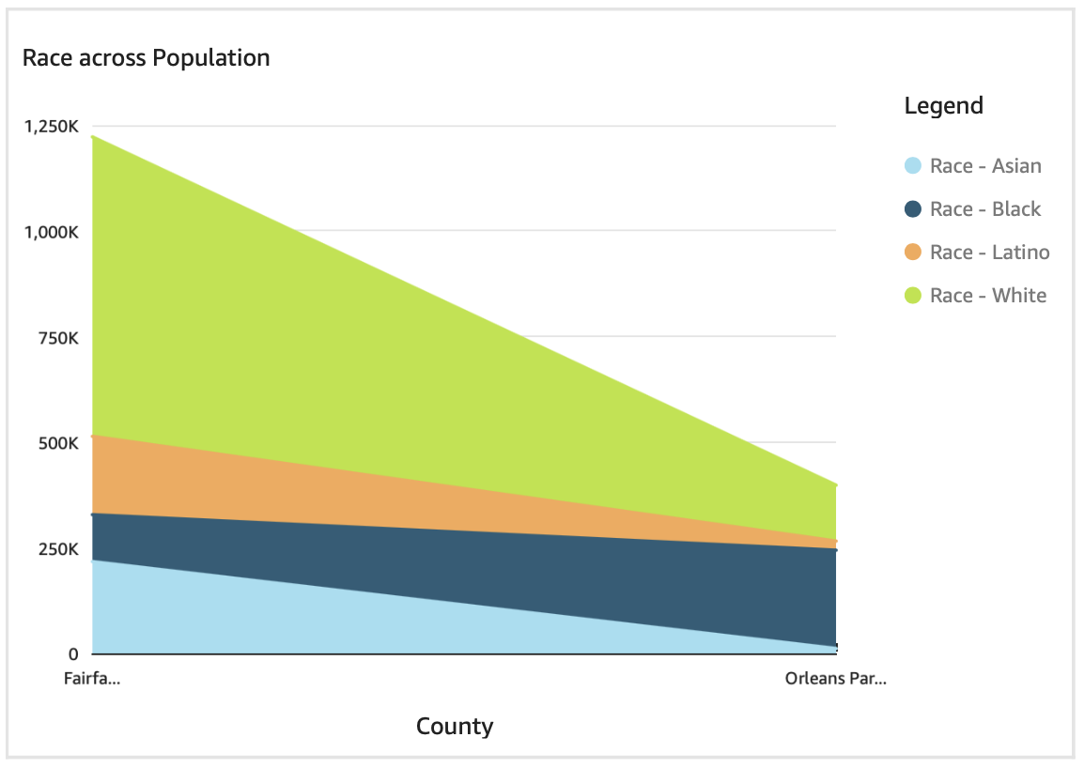
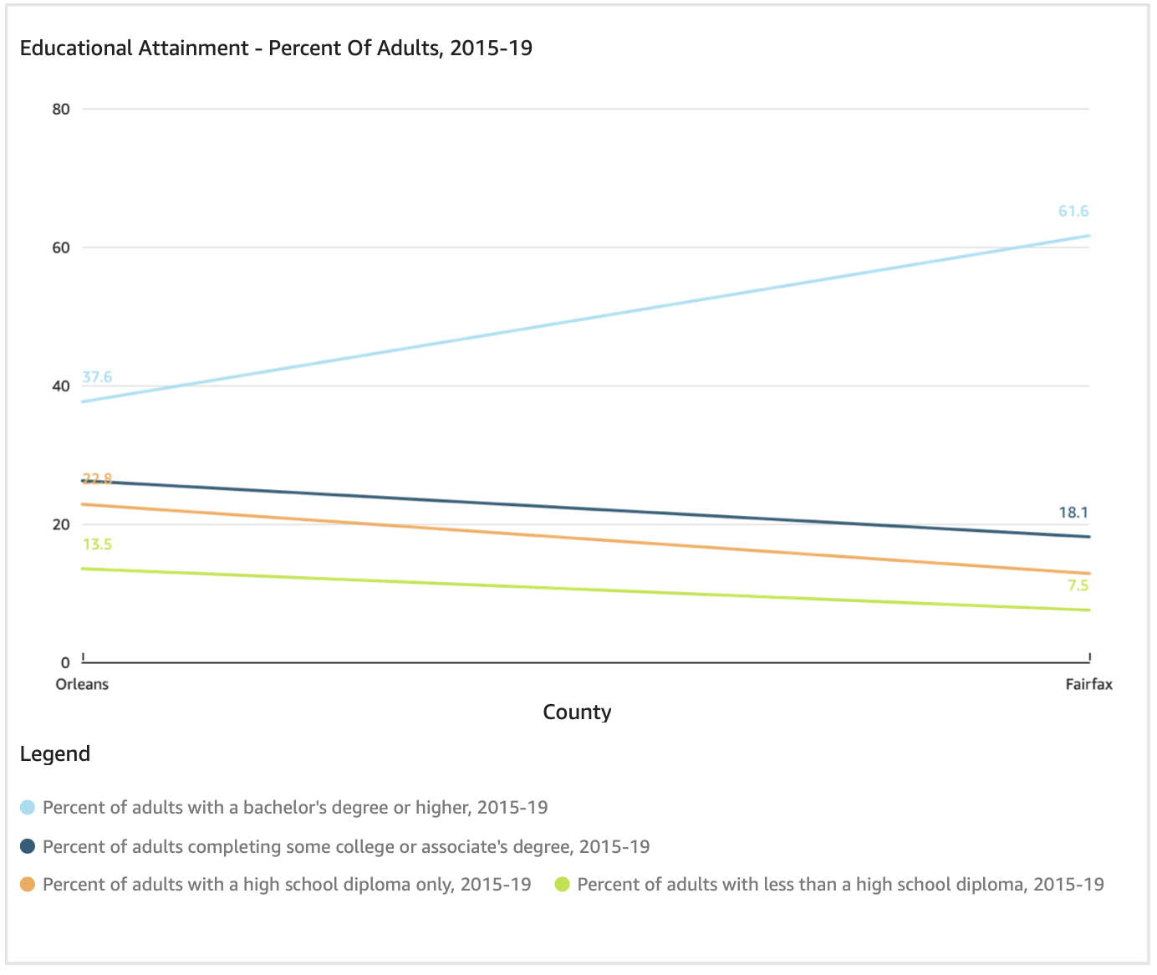
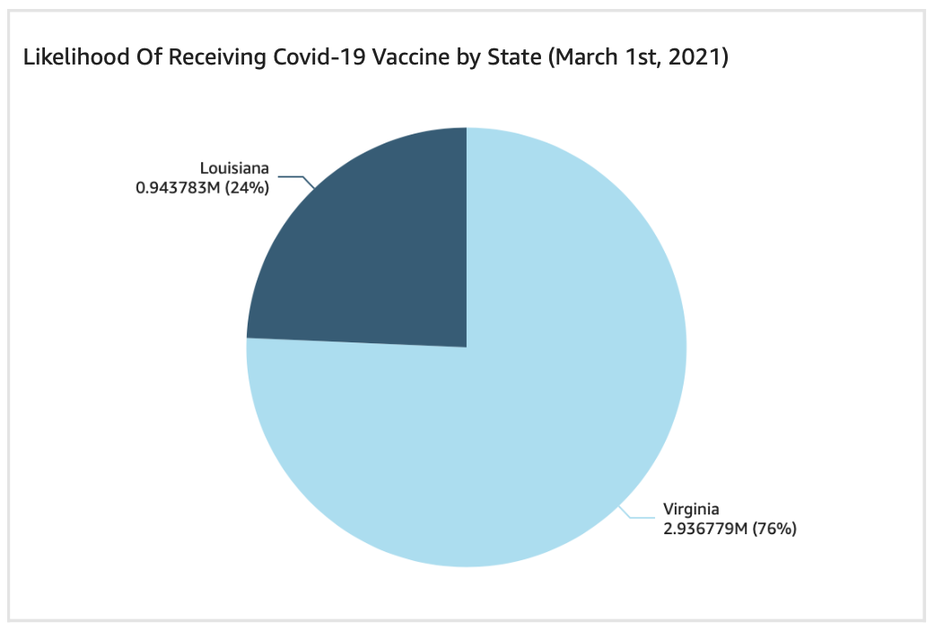
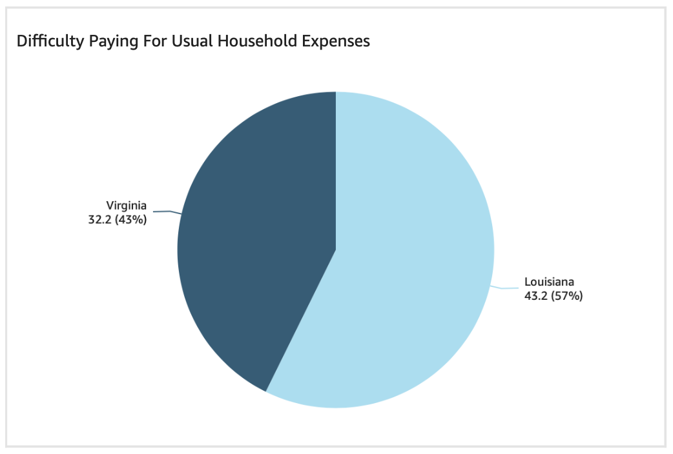
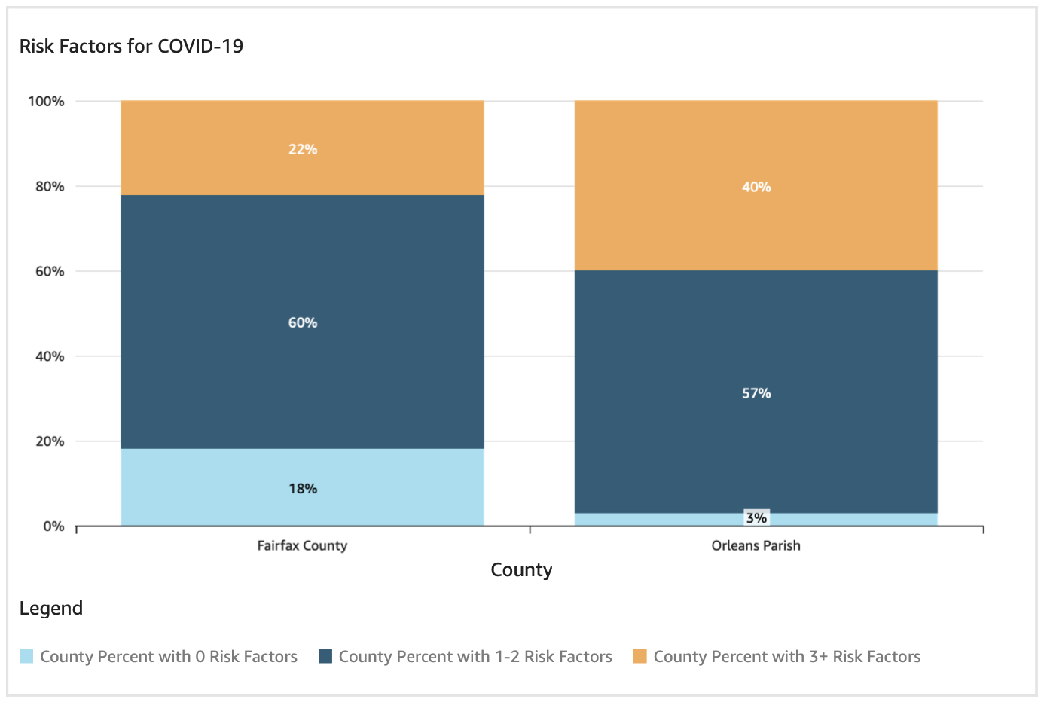
Visualizations

Slide 6
Population, Race, and COVID-19 Risks
Data from U.S. Census’ American Community Survey, Population Estimates, and the National Health Interview Survey.

Slide 7
Public Health Models

Slide 8
Educational Attainment and Health Disparities
Combating COVID-19 in Minority Communities
Orleans Parish has more risks than Fairfax County and risks can contribute to higher infection rates.
The Health Belief and Socioecological Models suggest improvements to susceptibility, benefits, community, and public policy.
Orleans Parish residents are getting vaccinated but there seems to be issues with access to the vaccine.
Data from U.S. Census’ American Community Survey, Population Estimates, and the National Health Interview Survey.

